Slide 1
MODULE 1
Faizal K
Asst. Professor
Dept: of Mechanical Engineering
School of Engineering, CUSAT

Slide 2
TOPICS (part 1)
Basic concept of management
Definition, Characteristics and Levels of management
Functions of management
Scientific management
Contribution of Gilbreth-Gantt
Management by Objective (MBO)

Slide 3
Basic concept of management..?? (c/w)

Slide 4
definition
Management is an art of getting the work done through the efforts of people and by the effective utilisation of resources.
For getting the work done, it is necessary to guide, direct, coordinate and control human efforts for the fulfillment of the goals of the enterprise.
Management does not frame policies, it only implements/executes the policies laid down by the administration.

Slide 5
CHARACTRISTICS OF MANAGEMENT
Management is a purposeful activity: Objectives differ from organisation to organisation
Efficient management of economic resources
Management is a distinct process
Management is universal: applicable to all group of activities
As a team of managers and system of authority
Co ordination is the soul of management
Management is dynamic
Management is decision making
Management is a profession

Slide 6
LEVELS OF MANAGEMENT
The 3 levels of management that are commonly found in an organisation are:
Top management
Middle management
Lowest or supervisory management
Board of Directors, MD, CEO, GM
Departmental heads, Superintendents
Foreman, supervisors etc
Top
Level
Middle Level
Lowest Level

Slide 7
Functions of management
Planning
Forecasting
Organizing
Staffing
Directing
Coordinating
Controlling
Decision making
Motivating
Communicating

Slide 8
1. Planning
It is the most important and prerequisite of all the other functions.
It is the process of establishing goals and suitable course of action to achieve that goals.
It consists of goals, policies, procedures, rules, strategies etc
It is done in accordance with past events and forecasting events in the future.
2. Forecasting
It is defined as an estimate of future events, by systematically combining past and present data.
It forms the basis of planning of activities of an organization.
The survival of any manufacturing enterprise depends on its ability to assess, with reasonable accuracy, the market trends several years ahead.
Forecasting begins with sales forecast and is followed by production forecast and forecast for costs, finance, purchase, profit etc.

Slide 9
3. Organizing
Organizing is the process of arranging and allocating work, authority, and resources among an organization’s members so that they can achieve organization’s goals.
The process of organizing involves:
Identifying the works to be performed
Classify the work or group the work
Assigning activities to the groups or work to individuals
Fixing responsibilities
Deciding the hierarchy of authority

Slide 10
4. Staffing
It involves manning the positions created by organization process.
It is a process of filling or keeping filled the various positions in the organizational structure.
It involves:
Manpower planning (both in quantity and quality)
Recruitment selection and training
Placement of manpower
Conducting periodic appraisal
5. Directing
Directing is said to be a process in which the managers instruct, guide and oversee the performance of the workers to achieve predetermined goals.
It includes:
Leadership (inspiring confidence and trust) c) Communication
Motivating d) Supervision

Slide 11
6. Coordinating
Coordination is the process of integration of the activities of separate departments of an organization to accomplish organizational goals.
It involves harmonizing the individual goals of the subordinates with the goals of the organization
The extent of coordination depends on the nature of activities performed and the type of organization structure.
7. Controlling
Controlling is the process of ensuring that actual activities conform to plan activities.
It measures the progress of operations and making sure that things are proceeding in the right direction as planned
It involves:
Establishing standards of performance.
Measuring actual performance.
Comparing actual performance to the established standards.
Taking corrective action if deviations are detected.

Slide 12
Decision making
Decision-making is the process of identifying and selecting a course of action from among alternatives.
Decision-making is an important part of every manager’s job and it requires all the skill and judgment a manager accumulates over the years.
Motivating
It means inspiring people to intensify their desire and willingness to perform their duties effectively and co-operate for the achievement of common objectives of the business.
Motivation is a human psychological characteristic.
It pertains to various drives, desires, needs, wishes and other forces.

Slide 13
10. Communicating
It’s a process by which instructions, ideas, thoughts or information are transmitted, received and understand by persons working in organisation.
Methods of communication are:
a. Verbal or written communication
b. Formal or informal communication

Slide 14
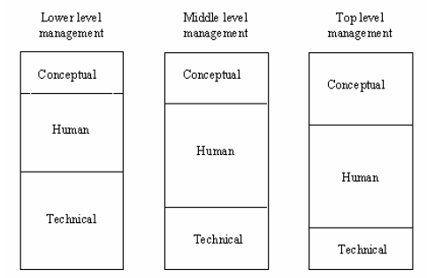
MANAGERIAL SKILLS
It’s the ability of a manager to make a smooth functioning team of people working under him.
It involves obligation to make effective utilization of human and material resources.
Types
Technical skills
Conceptual skills
Human relational skills

Slide 15
1. Technical skills
It refers to the proficiency in handling methods & techniques to perform particular tasks.
2. Conceptual skills
It is the ability to coordinate and integrate the entire organizational interests and activities.
a) Decision making skill: ability to make accurate and right decisions at the right time.
b) Organizational skill: ability to recruit and allocate right person for the right job.

Slide 16
3. Human relational skills
It is the ability to build cooperative workgroups to achieve organizational goals.
a)Communication skills: ability to pass on information to others.
b)Motivating skills: ability to encourage the subordinates.
c)Leadership skills: ability to inspire confidence and trust in subordinates in order to have max. cooperation from them for getting work done.

Slide 17
Scientific management (F W TAYLOR)
“Art of knowing exactly what is to be done and the best way of doing it”.
It’s the result of applying scientific knowledge and the scientific methods to the various aspects of management and the problems that arise from them.
Helps to improve productivity and standardize human efforts.

Slide 18
Principles of Scientific Management
Development of science for each element of work:- analyze the work scientifically (what, when, who, how.??)
Scientific selection, placement and training of workers.
Division of Labour (POS)
Standardization of methods, procedures, tools and equipment.
Use of Time and motion study.
Differential wage system:- Doesn’t guarantee a min: wage
Co operation between Labour and management.
Principle of management by Exception:- Only significant deviations b/w actual performance and standard performance should be reported to top managers.

Slide 19
CONTRIBUTIONS OF GILBRETH
Helps to improve work methods and thus to discover best way of doing a job.
He defined “Motion study”, as the science of eliminating wastefulness resulting from unnecessary, ill-directed and inefficient motions.
He defined “Principles of motion economy”.
He introduced process chart.
He also identified Therbligs- the fundamental motions involved in doing an activity.
He developed micro motion study, invented cycle graph, chrono cycle graph and flow diagram.
Carried out studies on fatigue caused to the industrial worker and its elimination by allowing rest periods, improving working conditions, planning seating arrangement etc.

Slide 20
CONTRIBUTIONS OF GANTT
Improved differential piece rate wage system and introduced his task and bonus plan.
Developed a Gantt chart which is still used as a scheduling technique to compare between the planned work and the actual progress of work.

Slide 21
Management by objectives (mbo)
Management by objectives (MBO) is a management model that aims to improve the performance of an organization by clearly defining objectives that are agreed to by both management and employees.
It aims to increase organizational performance by aligning goals and subordinate objectives throughout the organization.
Ideally, employees get strong input to identify their objectives, time lines for completion, etc.
MBO includes ongoing tracking and feedback in the process to reach objectives.

Slide 22
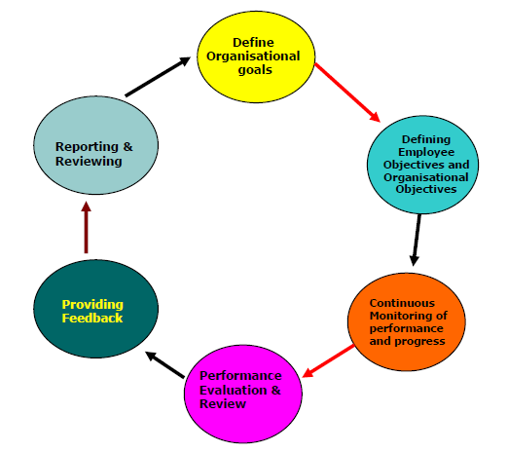
Mbo PROCESS
A process consisting of a series of interdependence and interrelated steps:
The formation of clear, concise statements of objectives
The development of realistic action plans for their attainment,
The systematic monitoring and measuring of performance and achievement.
The taking of corrective actions necessary to achieve the planned results

Slide 23
MBO Advantages & Disadvantages
Advantages
MBO programs continually emphasize what should be done in an organization to achieve organizational goals.
MBO process secures employee commitment to attaining organizational goals.
Disadvantages
The development of objectives can be time consuming, leaving both managers and employees less time in which to do their actual work.
The elaborate written goals, careful communication of goals, and detailed performance evaluation required in an MBO program increase the volume of paperwork in an organization.

Slide 24
TOPICS (part 2)
Introduction to Organization
Definition
Necessity and Elements of Organization
Process of Organization
Principles of Organization
Formal and Informal Organization
Organization structure
Types of Organization structure

Slide 25
Definition
Organization is a pattern of relationships among the individuals working together for a common goal.
It is a system consisting of men, materials, machinery and money working for a common goal.
It is concerned with building, developing and maintaining of effective machinery for accomplishing the objectives of the enterprise.
Eg: Banking system

Slide 26
Necessity of organisation
Complexity of Industry
Growing Competition
Optimum utilization of resources
Fixation of authority and responsibility
Reduced labour problems
Co-ordination and directing efforts
Facilitates administration
Stimulates creativity.

Slide 27
essential Elements of good organization
It must be helpful in the achievement of objectives.
There must be harmonious grouping of activities.
The activities of the organisation must be co- ordinated properly.
An organisation must be complete in all respects.
An organisation should have an effective communication system.
The Span of control should be reasonable.
Provision of expansion
Clear and well defined policies and procedures
Employees satisfaction is essential
Proper division of authority and responsibility.

Slide 28
Process of Organisation (Steps in Organising process)
Determination of objectives, strategies, plans and policies.
Determination of activities
Separation and grouping of activities
Delegation of authority
Delegation of responsibility
To establish inter-relationships
Providing physical facilities and proper environment
Preparation of Organisation chart

Slide 29
Principles of Organisation
Consideration of unity of objectives: the objectives must be clearly defined for the entire enterprise, for each dept. and even for each position in the organisation structure.
Principle of specialization: Work should be distributed among the persons very carefully on the basis of their skill, experience and ability to do that work.
Principle of authority: Line of authority should be clearly established in the structure of organisation in order to avoid overlapping actions, omission of acts etc.
Principle of Co-ordination: Different depts. should have to co-ordinate with each other to achieve common goals.
Principle of unity of command: Each sub ordinate should have only one superior and dual sub ordination should be avoided.
Principle of Span of control: The no: of persons who are directly responsible to the executive is called span of control. In an average firm SOC range is from 6 to 20.

Slide 30
Principle of exception: Only exceptionally complex matters should be referred to the executives for their decision and matters of routine nature should be decided by the sub-ordinate themselves.
Principle of flexibility: The organisational structure should be flexible enough to permit slight alterations and expansions whenever needed, due to changed circumstances.
Principle of simplicity: The organisational structure should be simple with minimum no: of levels
Principle of Responsibility: the superior should be held responsible for the acts of his subordinates to whom he has delegated authority.
Principle of balance: There should be balance between;
-the activities
-authority and responsibility
-standardization of procedures and flexibility
-centralization and decentralization

Slide 31
Principle of continuity: The Org. structure should be in such a way that it enables to continue its useful existence for a longer period.
Scalar principle: The authority originating from the top should flow below without any interruption.
Principle of parity between authority and responsibility: Authority means ability of the superior to command and responsibility means the obligation of the subordinates to a superior to perform the assigned task. Both should go hand in hand.
Principle of efficiency: Enabling the enterprise to attain objectives with minimum cost and effort.
Principle of Communication: A good communication system is essential for smooth flow of information.

Slide 32
Types of Organisation
Formal Organisation
FO are those which have a system of well defined positions, authority, responsibility, rules, policies, principles etc.
They are co ordinated towards a common objectives.
Informal Organisation
Arises from the personal and social relations of the people which may or may not be work related.
They bring cohesiveness and comes along with the formal organisation.

Slide 33
Organisation Structure
OS means the systematic arrangement of people working for the organisation and their relationship b/w positions.
It defines the functions to be performed, objectives to be established, the availability of resources, working relationship of the individual participants etc.
Factors
Size of Org.
Nature of the product being manufactured.
Complexity of problem being faced.

Slide 34
Types of Organisation Structure
1. Line Organisation
Based on similarities of activities, diff depts: are created.
Each dept is placed under one dept head & he has the full authority all over them.
Authority flows from top to bottom in a vertical line.
Unity of command is maintained.
Superior will be responsible for the performance of sub ordinate to his commanding officer.

Slide 35
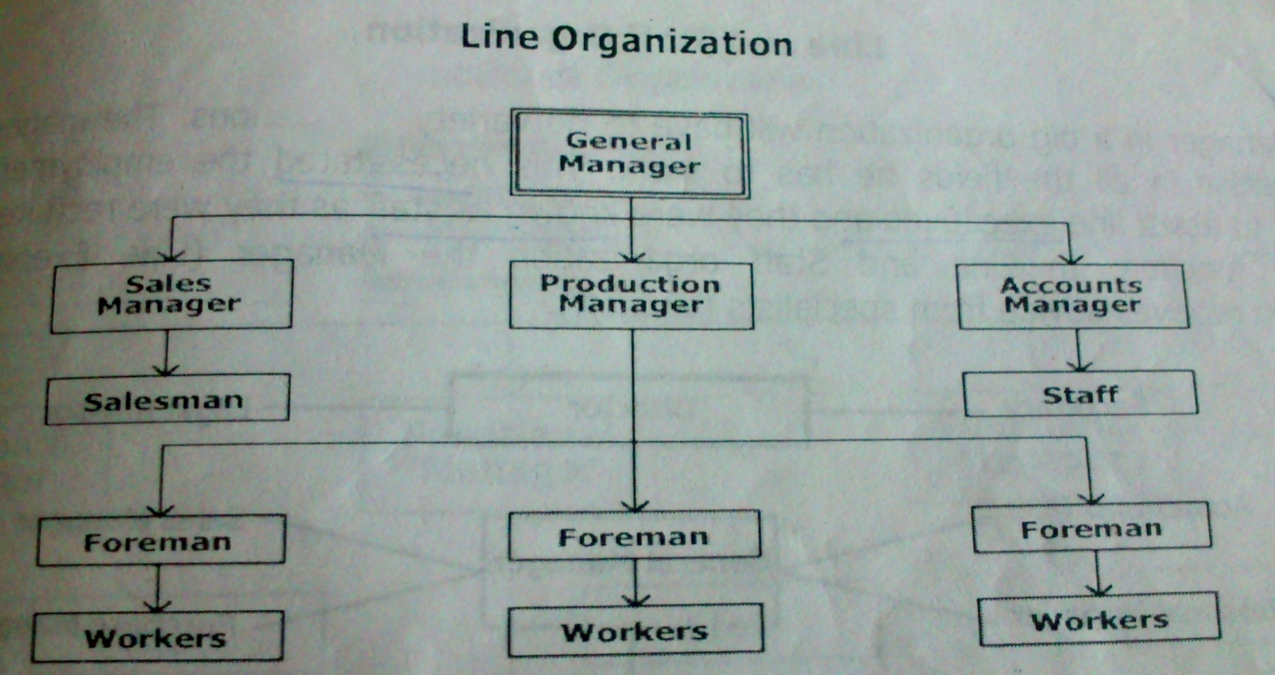
Line Organisation

Slide 36
2. Functional Organisation
Modified form of line organisation
Authority rests with functional heads
Staffs are grouped and located by specialty into functional depts: each headed by a functional manager. Each member of staff has one clear boss.
Functional manager are specialists in their respective areas and is based on high degree of specialization.

Slide 37
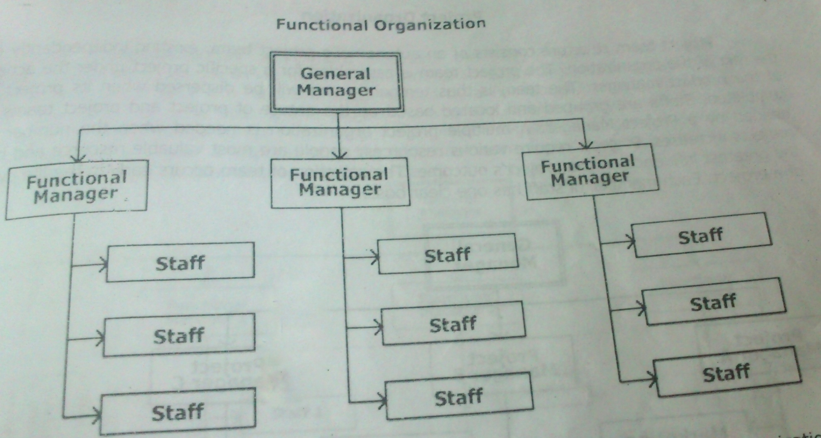
Functional Organisation

Slide 38
3. Line and staff organisation
In a big organisation manager will have to do a variety of functions and he may not be expertise in all areas.
Special executives will be employed to assist line executives and they were known as staff, whom to perform specialized function.
Supervisory authority will be given for line executives and the staff executives gives advices and expert opinion.

Slide 39
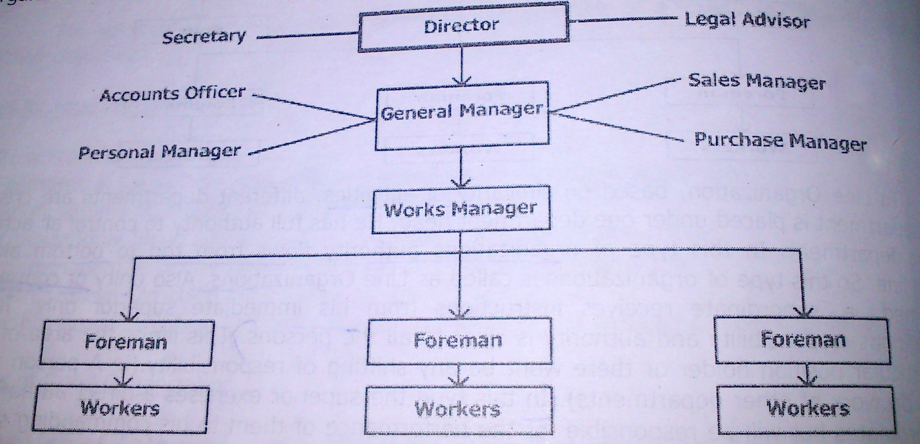
Line and staff organisation

Slide 40
4. Project Organisation
It consist of an autonomous project team, existing independently of the rest of organisation.
The project team is assembled for a specific project under the action of project manager.
The team is thus temporary and will be dispersed when the project is completed.

Slide 41
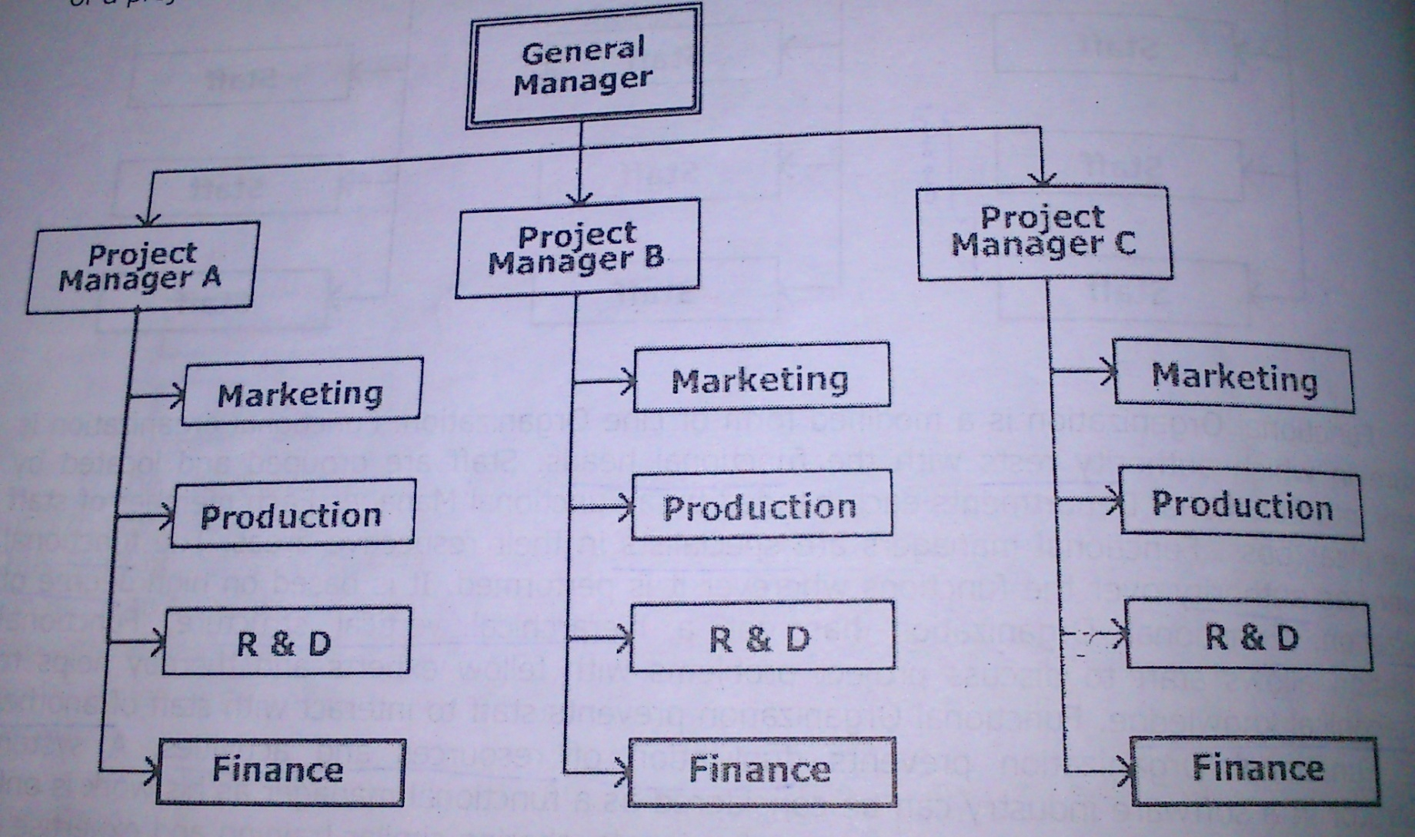
Project Organisation

Slide 42
5. Matrix Organisation
They are those that comes b/w fully functional and fully project organisational structure.
Staffs are grouped and located by speciality into functional units headed by a functional manager.
The project manager works with the functional manager for timely completion of project.

Slide 43
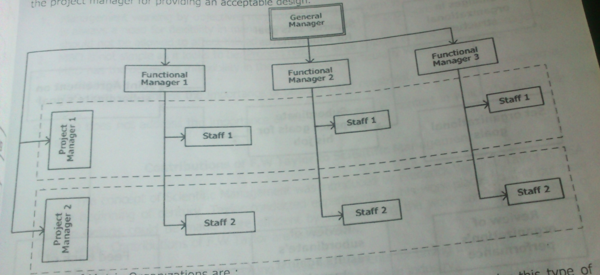
Matrix Organisation

Slide 44
Topics (part 2) Forms of business organization
Concept of Ownership organization
Types of ownership
Individual ownership
Partnership
Joint stock company
Private and public limited company,
Co-operative organizations
State ownership
Public corporation

Slide 45
Ownership Organisation
A firm is an Ownership organisation which combine the factors of production (4M) in a plant for the purpose of producing goods or services and selling them at profit.
Factors
Size and nature of organisation
Technical difficulties
Market competition and scope of articles in markets
Capital required
Limitations and restriction put forth by govt.

Slide 46
Types of Ownership
Private Sector
1. Individual Ownership
2. Partnership
3. Joint Stock Company
Public Sector
1. Departmental Organisations
2. Public corporations
3. Government Companies
Co operative sector
1. Producers Co Op: society
2. Consumers Co Op: society
3. Housing Co Op: society
4. Co Op: Credit society

Slide 47
PRIVATE SECTOR
Private sector organizations, as the name indicates, are exclusively owned by private individuals.
The efficiency of the private sector organizations is usually very high
compared to organizations from any other sector.
1. Individual Ownership
Simplest and oldest form of Organisation.
Individual entrepreneur supplies the entire capital.
Entire Authority & responsibility belongs to him and also the profit and loss.
In Short it’s a “one man business”, if need he can employ a person to assist him.
Applications.
Small scale industries
Risk covered is not too heavy
Management by 1 man is possible

Slide 48
2. Partnership Organisation
Owned by 2 or more persons who share the power, responsibilities and profits according to an agreement reached amongst themselves.
Person may possess exceptional business ability, experience, talent but no capital, then he can have a financing partner (vice versa).
“Partnership deed” – written agreement

Slide 49
3. Joint Stock Company
Legal business owned by the shareholders having limited liability and managed by an elected Board of Directors.
Capital is contributed by large no: of persons in the form of shares of different values.
Persons who purchase shares are called Share Holders and managing body is known as Board of Directors, whom elected by the SH.
Types
a. Private Ltd Company
b. Public Ltd Company

Slide 50
a. Private: Ltd Company
Owned and managed by a group of members from family, relatives or friends.
Formed by 2 or more members & max is limited to 50.
Transfer of share is limited to members only and general public cannot be invited to purchase shares.
Eg: Indus motors, Popular automobiles etc

Slide 51
b. Public Ltd company
It is opened to general public
Min no: of persons are 7 and there is no upper limit.
They are subjected to greater control and supervision of the govt.
Shares are transferable without any prior approval.
The affairs of company are managed by BOD
Eg: Reliance India Ltd, L&T Ltd, Tata etc.

Slide 52
Private Ltd Company Vs Public Ltd Company
SL No | Basis of Description | Private Ltd | Public Ltd
1 | Minimum no: of members | Two | Seven
2 | Maximum no: members | Fifty | Unlimited
3 | Invitation of public for capital | No | Yes
4 | Transferability of shares | Restricted to members | Free
5 | Secrecy | Possible | Not possible
6 | Prospectus | Not necessary | Yes, necessary
7 | Minimum no: of directors | Two | Three
8 | Exemption from legal restrictions | Yes | No
9 | Quick Decision | Possible | Not Possible
10 | Protection to members | Less | More

Slide 53
CO OPERATIVE SECTOR
Its an Organisation where in persons voluntarily associate as human beings for the fulfillment of their common economic interests.
Set up with a primary objective of helping its members rather than making profit.
Types
1. Producers Co Op: society
2. Consumers Co Op: society
3. Housing Co Op: society
4. Co Op: Credit society

Slide 54
Producer’s Co operative society
They are formed to protect the interest of small producers by making available items of their need for production (like raw materials, tools etc)
For buying and selling the products, produced/cultivated by the members to eliminate middlemen and get better prices.
Eg: handlooms, coir, handicrafts etc.
2. Consumer’s Co operative society
For the retail trade of household and consumable items.
Eg: Stores in School & Colleges.

Slide 55
3. Housing Co operative society
Formed for the purpose of getting plots or constructing houses for needy persons by providing loans, reducing cost of construction etc.
4. Co operative credit Society
It’s objective is to finance the poor cultivators by providing loans at low ROI for developing land, buying agro machineries etc.
Formed by persons working in the same organisation to provide loans to the members in case of financial difficulties etc.

Slide 56
PUBLIC SECTOR
Owned and managed by Central or State government.
Controlled and operated by the govt: or in association with private enterprises.
Capital is invested by the govt: or govt: controlled financial institutions like LIC, UTI, Public sector banks etc.
Public Sector Undertaking (PSU) is a term used to refer companies in which the govt: owned a majority (51% or more) of the company equity.
Eg: Iron &steel industries , fertilizers, defense industries etc.

Slide 57
1. Departmental Organizations
It’s the business organisation which are owned, managed and run by the govt: or local bodies like municipality, district board etc.
Generally done in the case of water supply, electricity, gas, bus, railways, navigation etc.
Social benefit is of primary importance while profit motive is given as secondary consideration.
Eg: Railways, Posts and Telegraphs etc.

Slide 58
2. Public Corporations
Owned by the govt-either Central, State or local bodies.
It is managed by the Board of Directors nominated by the government.
It combines the public interest of the govt body & autonomous management of the public sector.
They have no profit motive and work for the sake of social welfare.
Eg: FCI, ONGC, Financial corporation, Industrial development corporation etc.

Slide 59
3. Government Companies
A govt: company is any company in which not less than 51% of the share capital is held by the Central or State govt: or partly by both.
Managed by elected Board of Directors.
Eg: FACT, HAL, HLL, HMT etc.

